Slide 1

Office 365 Setup

Slide 2
Links
TCC Guide:
http://blogs.tccd.edu/studentannouncements/2016/05/03/free-microsoft-office-365/
PDF Guide:
http://blogs.tccd.edu/studentannouncements/wp-content/uploads/sites/35/2015/09/Free-Microsoft-Office-3651.pdf

Slide 3
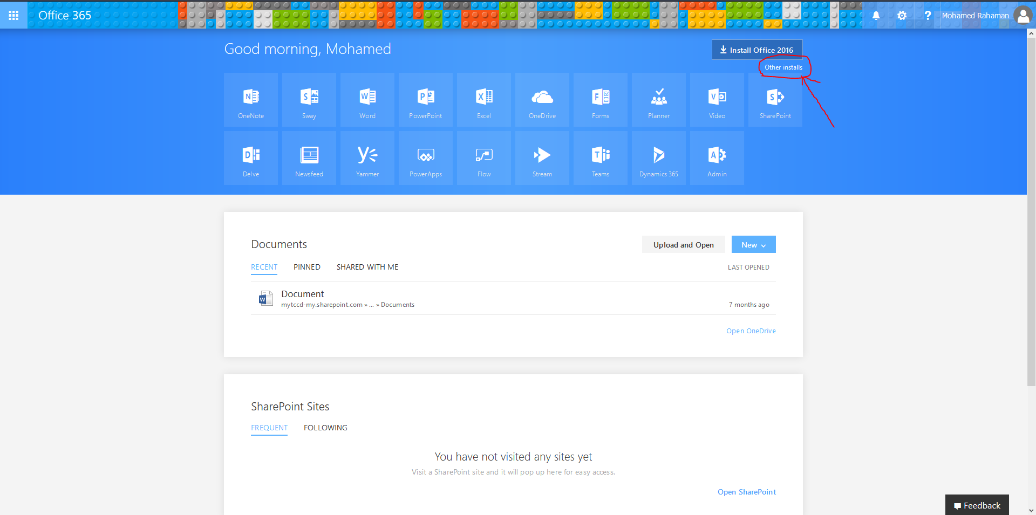
Select other Installs for more options.

Slide 4
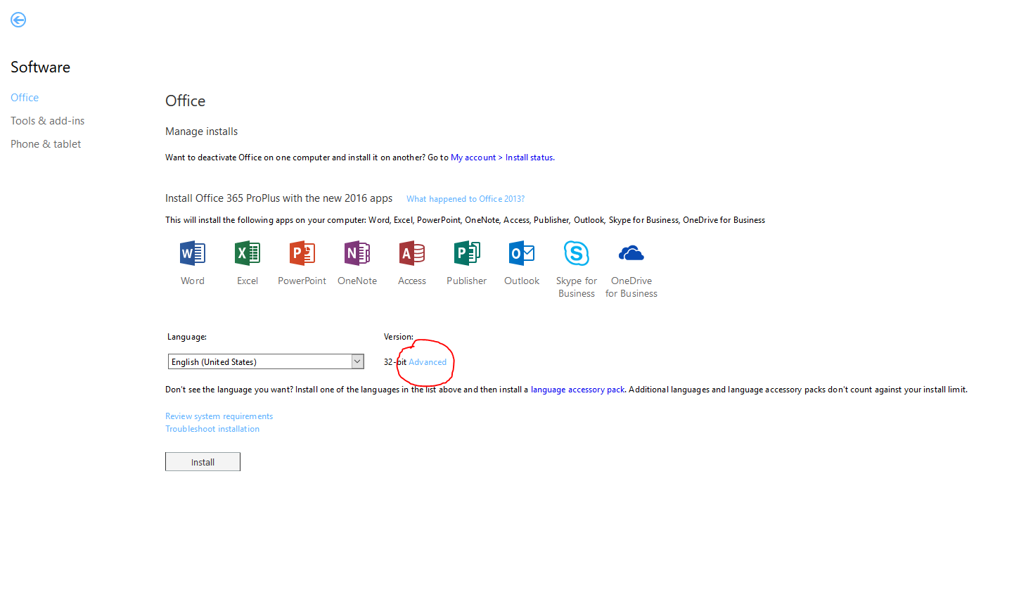

Slide 5
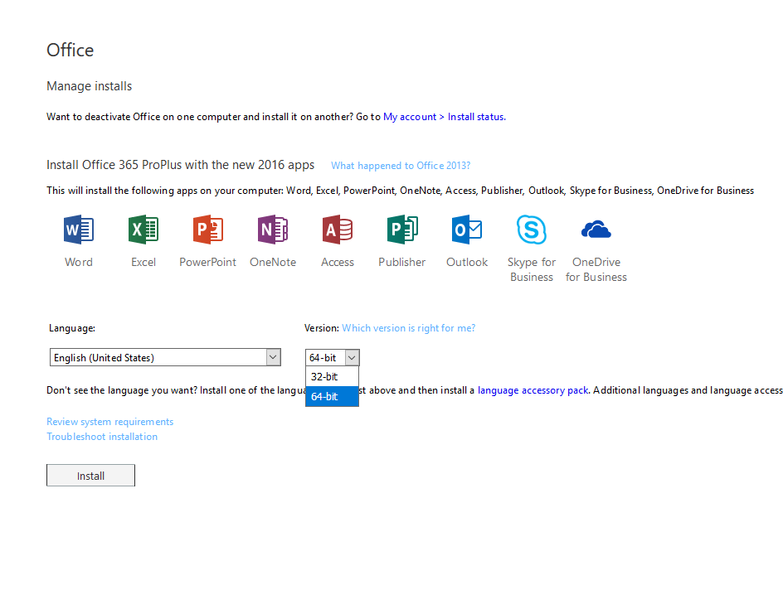

Slide 6
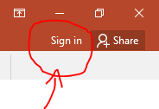
Common Issues
After installation go to the sign in at the top right of the Office 365 apps and sign in to your Office 365.
If you don’t know your login reset your password to gain access to your account.
Check that you have the right email address when signing in Office 365.

